Slide 1
MCTV Limited
Group Project by:
Remigija Vindasiute(x17432284)
Ioana Avram(x17448556)

Slide 2
Introduction
MCTV limited is a small retail company located in Limerick.
Main products of this company are TV’s.
Company was created by Michael Cooney and his wife Doreen.
The staff consists of 5 people currently.
4 out of 5 staff members are family members.

Slide 3
Division of the Tasks
Database Tasks:|
Tables/Reports/Forms (Ioana)
Queries/Suggestion Form/Data (Ioana)
Customisation (Remigija)
UML tasks:
Pick actors/pick use cases (Remigija)
Make descriptions for use cases (Remigija and Ioana)

Slide 4
Division of the Tasks
WordPress Tasks:
Choose pages and layout/add content (Remigija)
Individual Report tasks:
Make a report (Remigija and Ioana)
Presentation Tasks:
Make slides/ add content/choose layout (Remigija)
Other Tasks:
Create GitHub repository/trello boards/Gantt Chart (Remigija)
Choose a colour scheme (Remigija)

Slide 5
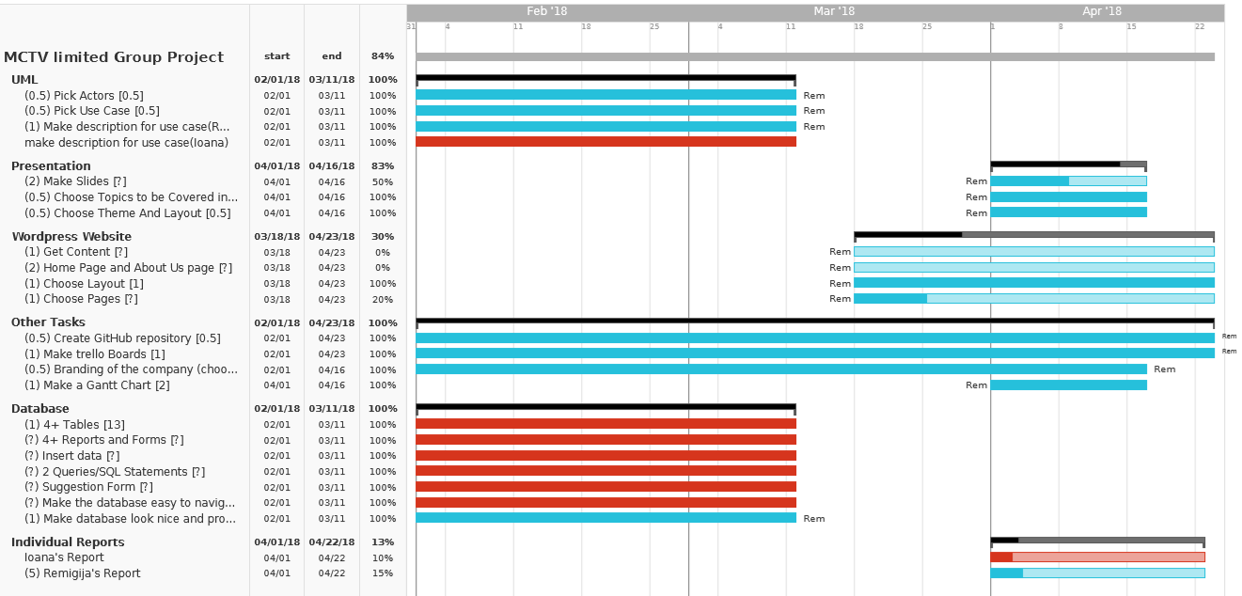
Division of the Tasks
Gantt Chart: Red=Ioana; Blue=Remigija

Slide 6
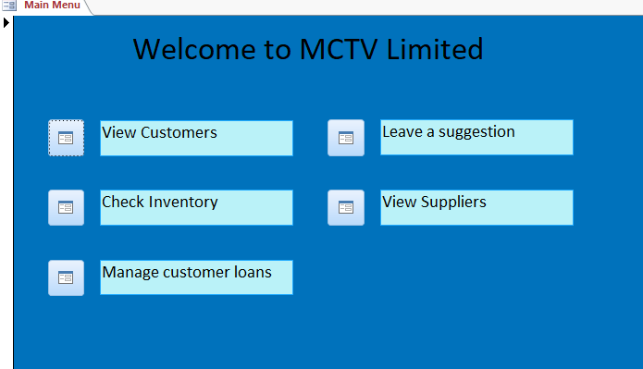
Overview of Database/UML
Main Menu of the Database:

Slide 7
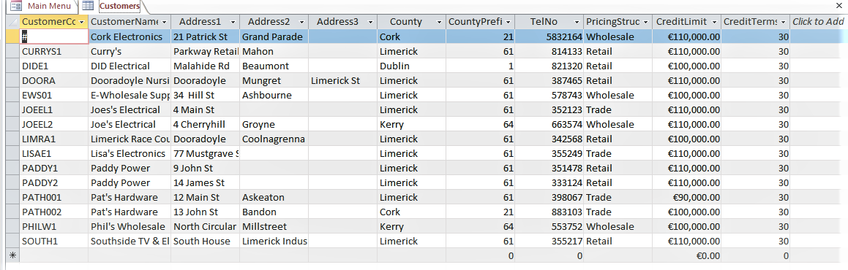
Overview of Database/UML
A sample table in the Database:

Slide 8
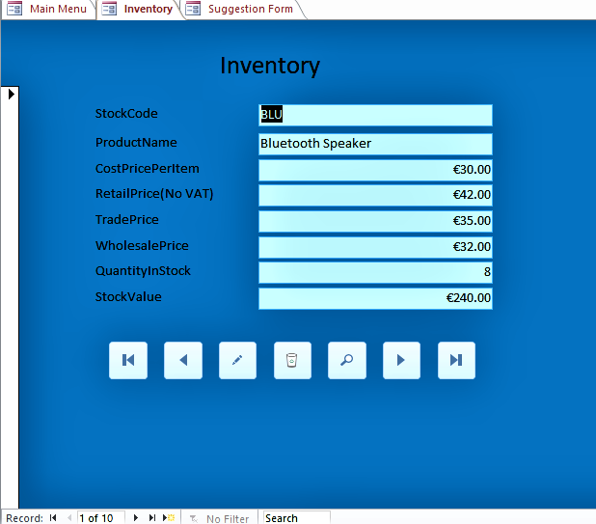
Overview of Database/UML
A sample Form in the database:

Slide 9
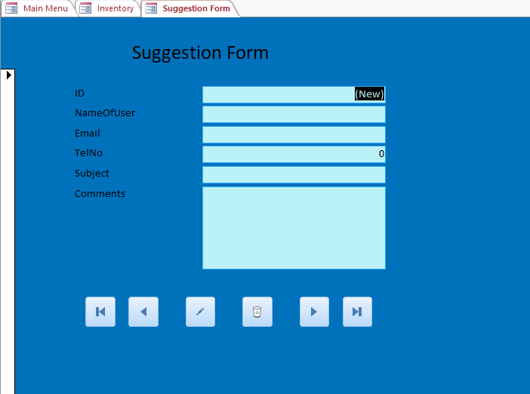
Overview of Database/UML
Suggestion Form:

Slide 10
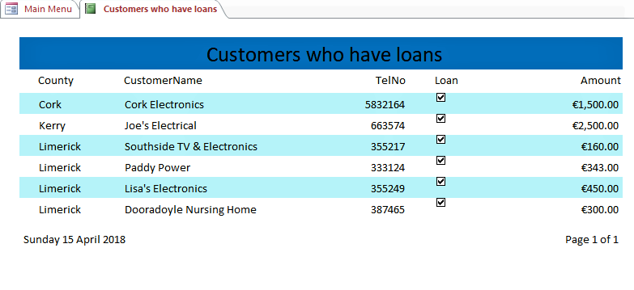
Overview of Database/UML
A sample Report in the Database:

Slide 11
Overview of Database/UML
UML diagram:

Slide 12
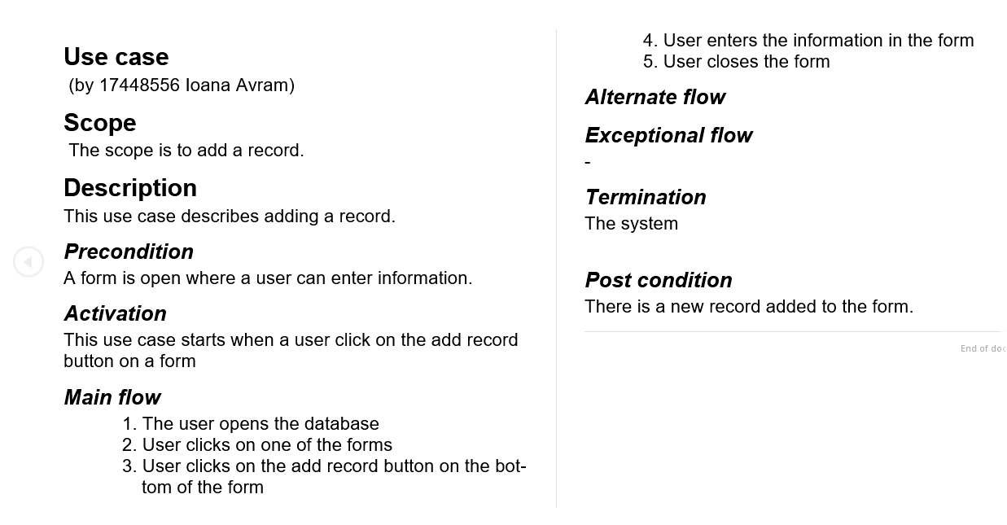
Overview of Database/UML
UML description by Ioana:

Slide 13
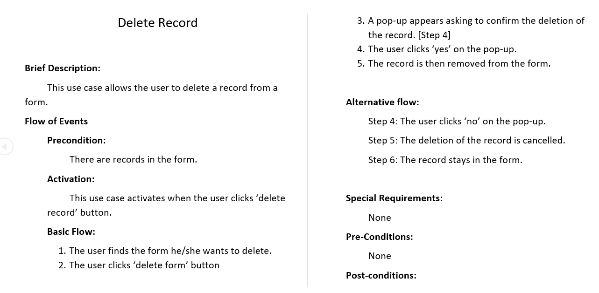
Overview of Database/UML
UML description by Remigija:

Slide 14
Software investigated

Slide 15
Branding

Slide 16
Conclusion

